Slide 1


Vanguard Initiative region’s pilots activities leading by example in the post industrial transition
European Week of Regions and Cities 2023
12.10.2023

Slide 2
Speakers
Patrick Brenier, Adviser for European Research Area (ERA) and Open science, DG RTD, European Commission
Stephan Satijn, Regional Minister for Economy, Finance, Business Operations and Public Affairs, Province of Limburg, South Netherlands
Kurt Gielen, Chief Business Officer Medace BV, Province of Limburg, South Netherlands
Gabriela Macoveiu, Director for Communication Innovation and External Cooperation, North-East Romania
Alenka Rožaj Brvar, Director, Slovenian Innovation Hub & SRIP Health Medicine, Slovenia
Aitor Mintegui Echalecu, EU Affairs Officer at the Delegation of the Basque Country to the EU, Basque Country, Spain
António Cunha, President of Norte Regional Coordination and Development Commission and of the Managing Authority of the Regional Programme 2021-2027 (NORTE 2030), Portugal
The session is moderated by Richard Tuffs, Friends of Smart Specialisation

Slide 3
The regional partnership
Province of Limburg, South Netherlands
North-East Romania
Slovenia
Asturias, Spain
Basque Country, Spain
Norte, Portugal

Slide 4
Patrick Brenier
Adviser for European Research Area (ERA) and Open science, DG RTD, European Commission

Slide 5
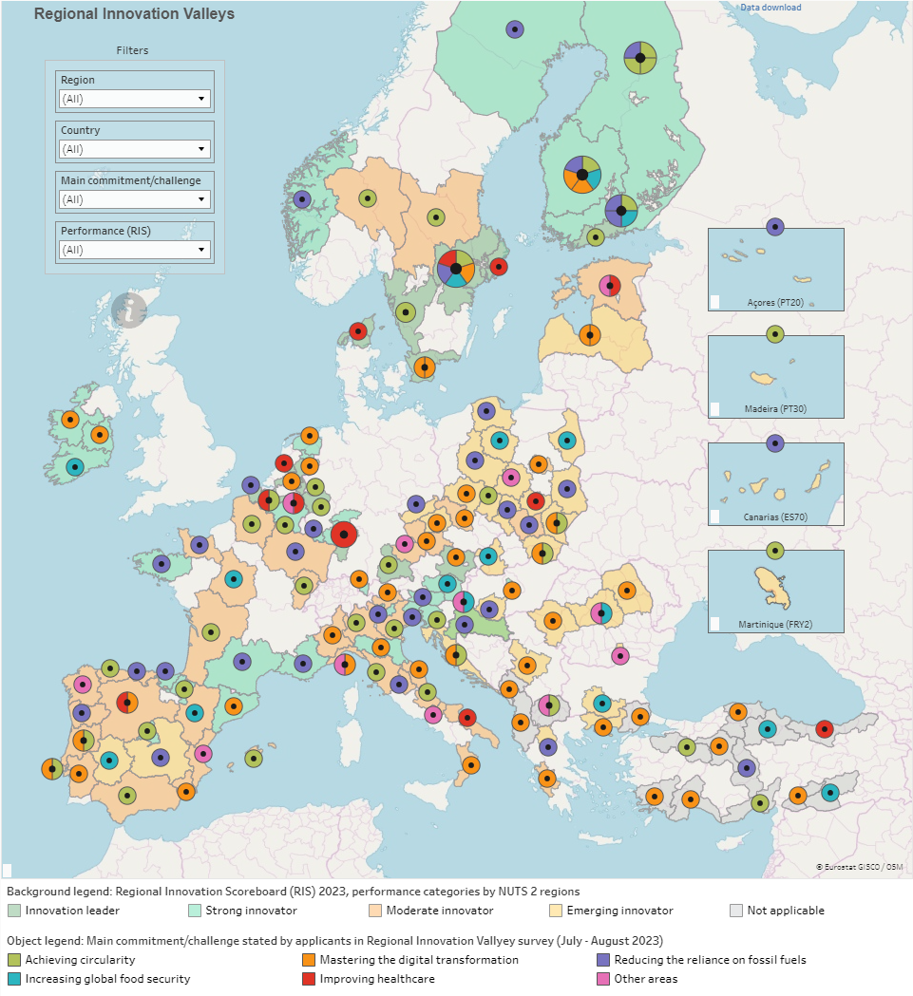

Slide 6
Stephan Satijn
Regional Minister for Economy, Finance, Business Operations and Public Affairs, Province of Limburg, South Netherlands

Slide 7




Vanguard Initiative Regions’ Pilot activities leading by example in the post-industrial transition
Norte Region of Portugal
António M. Cunha
President of Norte Portugal Regional Coordination and Development Commission
President of the Managing Authority of NORTE 2030
EWRC | House of the Dutch Provinces | 12-10-2023

Slide 8



North-East Romania Region and post industrial transition
Gabriela Macoveiu
Director for Innovation and Cooperation, North-East RDA

Slide 9
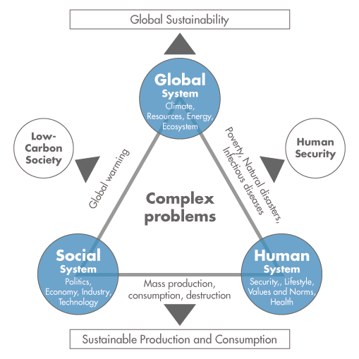
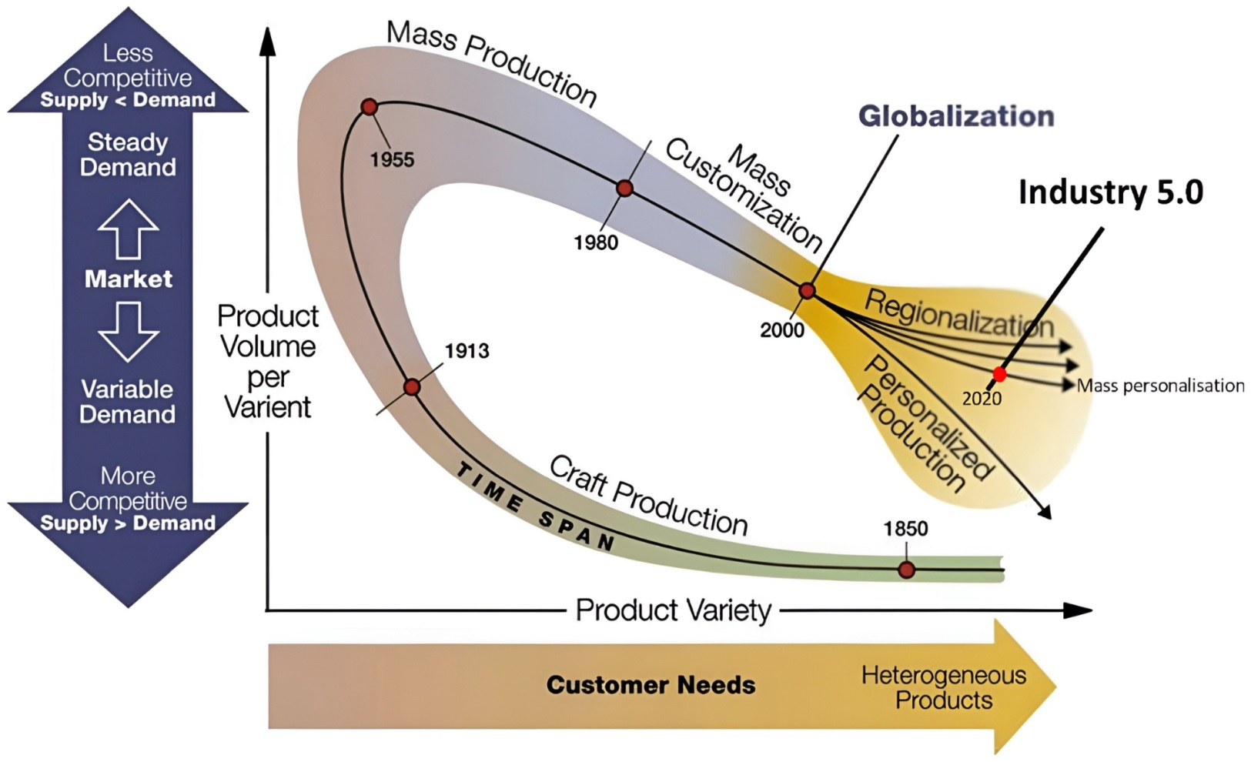
Current Global Context
Societal challenges
Shifting manufacturing paradigm

Slide 10
Industrial Transition Management Plan of Romania 2022-2027
Input for EC 1.6 Good governance of national or regional smart specialisation strategy
1. Readiness of the business environment regarding the adoption of Industry 4.0 specific technologies
2. Preparing the workforce for the jobs of the future
3. Inclusive economic growth and the transition to a climate-neutral economy in the perspective of adopting Industry 4.0
4. Governance of the industrial transition process (Industry 4.0) in Romania

Slide 11

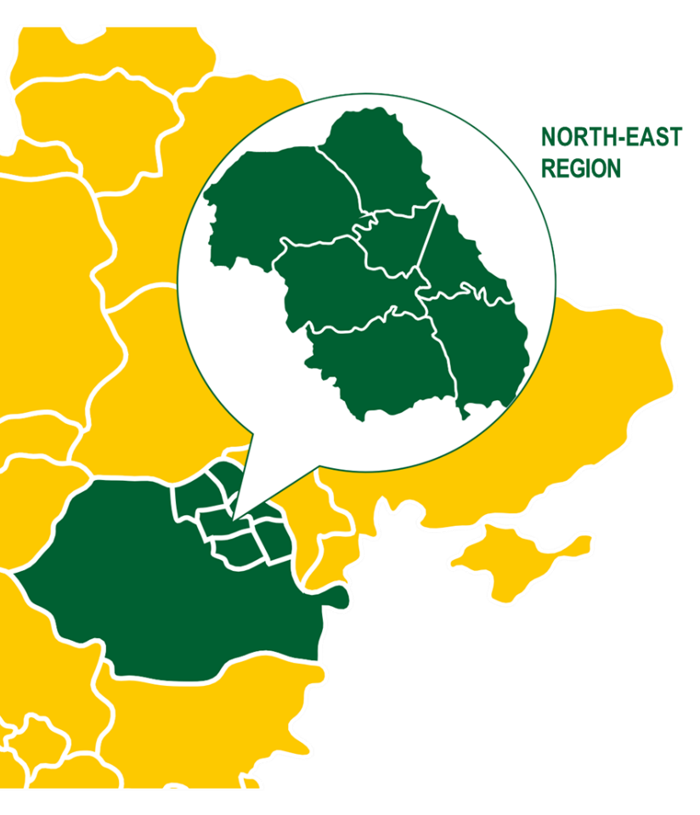
RIS3 North-East
MAJOR SOCIETAL CHALLENGES
Healthy aging, demographics and well-being | Food security, sustainable agriculture and bioeconomy | Clean, effective and safe energy | Safe and secure water
Sectors and Niches
AGRI-FOOD & WOOD INDUSTRY Sector
Smart-farming
Use of agricultural products for non-food purposes Environmental impact of agriculture
Biosecurity and food safety Forestry sector and wood industry
ENERGY Sector
Alternative energy sources Energy efficiency
TEXTILES Sector
High-tech processes and applications in textiles
Technical and functional textiles Digital Fashion
TOURISM Sector
IT&C solutions for tourism Marketing and creative promotion Healthy lifestyle tourism
Eco-tourism / Business tourism Cultural tourism
HEALTH Sector
Medical biotechnologies
Precision medicine
Prevention medicine
e-Health
Biosecurity
IT&C Sector
Industrial modernisation Cybersecurity Traceability and Big Data
Smart City and Smart Village
Development of new IT&C products hardware & software and test solutions
ENVIRONMENT Sector
Water (innovative solutions) Air (innovative solutions) Circular economy
Horizontal priorities
Development of innovation skills
Supporting innovative business
Development of regional research & development capacity
Supporting clustering / internationalisation initiatives
Administrative capacity and technical assistance

Slide 12
Implementation Strategy
Coordinator of RIS3 North-East and facilitator of regional EDP
MA for RP North-East 2021-2027(ERDF)
Connected with a Q4 community of practice
Strategic approach
P1. Encouraging development of skills for smart specialization, industrial transition and entrepreneurship
Access of SMEs to grant for training 1,75 mil. Euro ERDF RPNE
Introduction of new curricula for circular economy at University Vasile Alecsandri in Bacau (Multitraces Project Circular Economy)
P2. Support innovative development of SMEs
P3. Promote RD development and collaboration with industry
Development of innovative clusters – 12 mil. Euro ERDF
Access to interregional cooperation projects – Interreg EUROPE (REPLACE, RETRACE, TRACS3, iWATERMAP, CLUSTERIX 2.0), Interreg DANUBE (TEX-DAN), Horizon Europe(TERRITORIA, AI REDGIO 5.0, SHEMAKES)
Access to thematic S3 partnerships – S3CoP, S3Ps, Smart Regional Investments in Textile Innovation (Cosme-TEX4IM), EIT Climate KIC (Climathon 2021, 2022), EIT Manufacturing, Vanguard Initiative (AI, Demo case for sustainable manufacturing)
Investments for circular economy – 30 mil. Euro ERDF
P4. Support for networking and cooperation:
Investments in RD infrastructure and applied research projects – 35 mil. Euro ERDF
Knowledge transfer projects – 6 mil. Euro ERDF
Digitalization – 60 mil. Euro ERDF
Provide business support services as EEN Regional Contact – innovation, sustainability and digital maturity assessment, matchmaking,

Slide 13


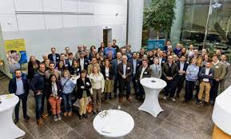
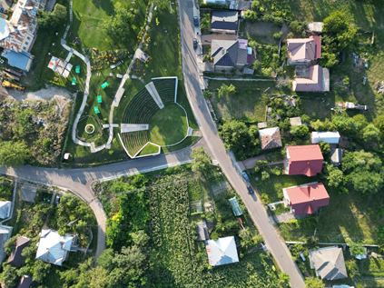
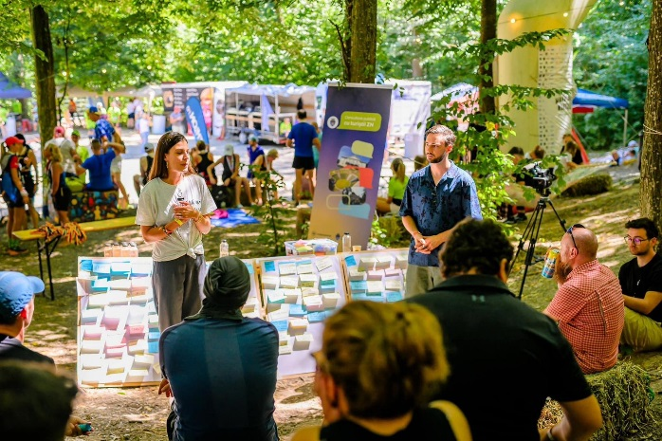
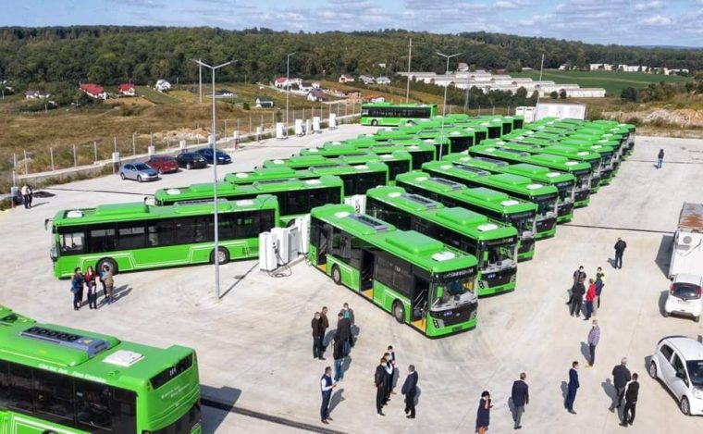
Green transition
SireNERGY - offering local communities hands-on experiences in developing specific strategies to improve the acceptance and deployment of renewable energy, thus unlocking the potential in rural areas.
Regiogreentex - textile recycling hub in line with the ReHubs initiative
Darabani – The town that writes its future together with the community Romanian Green Cities Alliance
Suceava – city participating in EU Mission: 100 Climate-Neutral and Smart Cities

Slide 14


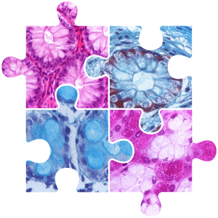


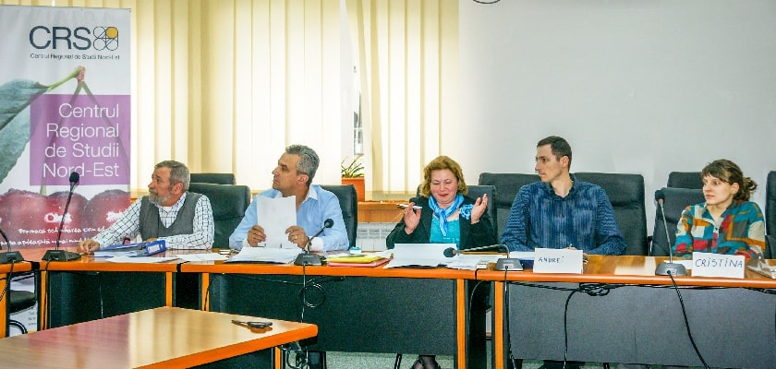

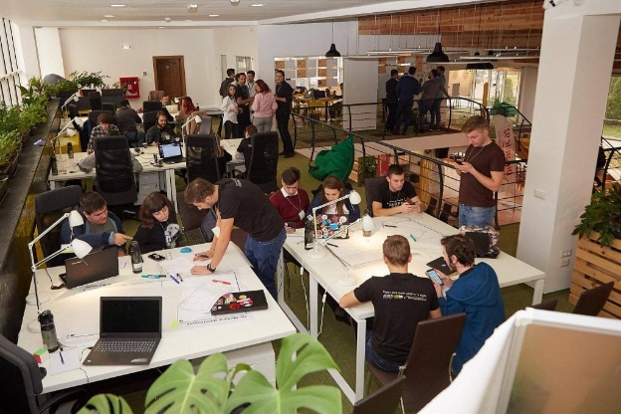

Digital transformation
Digital Innovation Zone the European Digital
Innovation Hub in the North-East region of Romania
Imago-Mol - North East Regional Innovative
Cluster for Structural and Molecular Imaging
Regional Studies Center North-East
Rubikhub – Startup community in North-East Romania

Slide 15

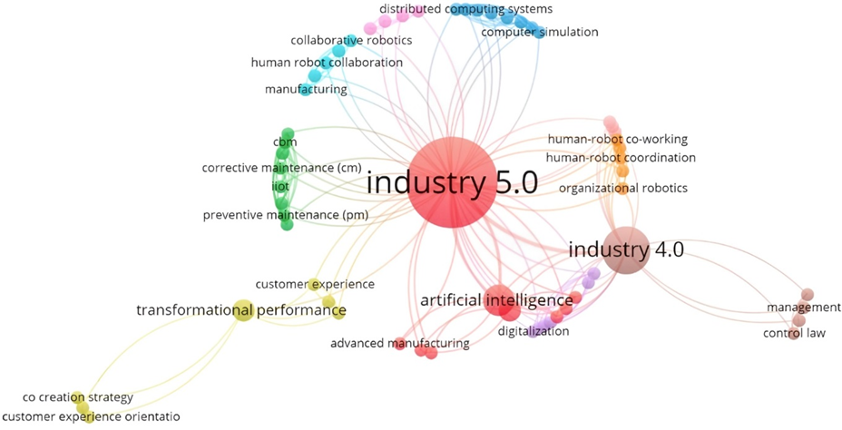
Contact
Lt. Drăghiescu nr. 9
610125, Piatra Neamț
România
0233 218.071
0233 224.168
0741 230.230
0233 218.072
adrnordest@adrnordest.ro
www.adrnordest.ro
www.inforegionordest.ro
company/adrnordest
adrnordest
Notes:
The industrial transformation is sociotechnical. Industry 5.0 is one of the recent terms to describe this phenomenon, defined as a humanized vision of technological transformations in industry, balancing the current and future needs of the workers and society with the sustainable optimization of energy consumption, materials processing, and product lifecycles.

Slide 16
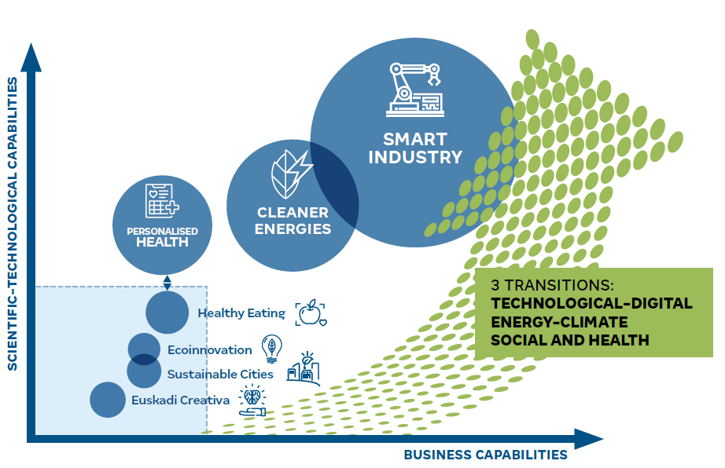

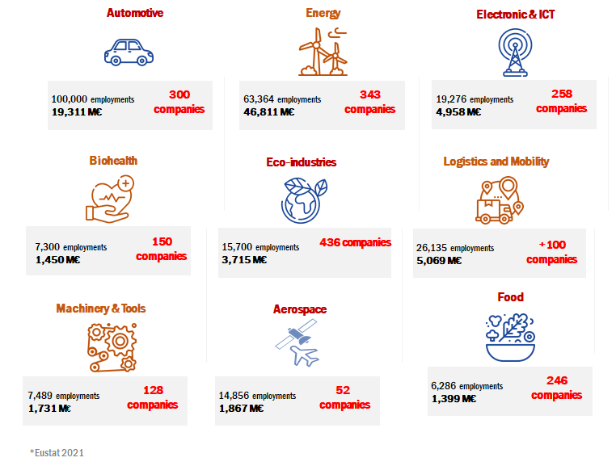
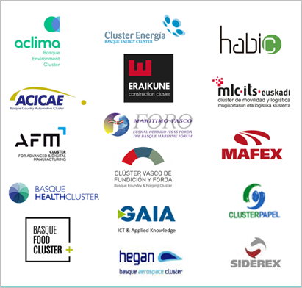

Basque Country and R&D&i
Basque RIS3 and Basque R&D&I ecosystem
Surface area: 7,234 km²
Inhabitants: 2,180,449
Population density: 304/km2
GDP (PPS/inhabitant): 108 (EU-27 = 100)
24% GDP
from industry
(almost 40% including advanced services)
+2,3% GDP
investment in R&D
(leading region in Spain)
Food
+2% Active population in R&D (over 14,000 researchers and 21,000 personnel)
Strong innovator
European RIS 2021
(best innovation performance among all regions in Spain)
3 Basque Universities
9 Basic Excellence Research Centres
The Basque Industry boasts an important network of clusters set up more than 25 years ago, aimed at improving business competitiveness through cooperation among SMEs, research agents and public administration
8 entities for Diffusion
5 Singular entities
4 Health Research Institutes
Basque R&D&I
Ecosystem
2 Health R&D organizations
25 Supply / Demand Intermediation Agents
10 Multifocused Technology Centres
52 Business R&D units
6 Sectoral Technology Centres
4 Cooperative Research Centres
BASQUE RESEARCH & TECHNOLOGY ALLIANCE
13 Technology Centers and 4 Cooperative Research Centres

Slide 17
Basque Country & Interregional Collaboration in Innovation
Founded the Vanguard Initiative in 2013 Together with 7 other regions to implement the outward looking dimension of S3. Co-leading the ADMA Energy and the AI pilot and participating in Efficient and Sustainable Manufacturing, Hydrogen pilots.
One of the few European regions that is participating in more than 5 S3 partnerships within the S3 Thematic Specialisation Platfoms
One of the 74 selected territories that takes part in the Partnership for Regional Innovation pilot (PRI) of the European Commission with the objective of improving the coordination and directionality of regional, national and EU innovation policies to implement Europe’s green and digital transitions.
Solid experience of collaboration in the design and implementation of funding instruments with other regions. Since the 6th Framework Programme the Basque Country has collaborated in 20 European initiatives to support collaborative R&D&i projects, has even coordinated one of these initiatives (MANUNET). Nowadays, the Basque Country is part of two ERA-NET Cofund and one co-funded European Partnership, all aligned with its RIS3: M-ERA.NET and ERA.MIN and Clean Energy Transition Partnership.
Notes:
As for the Basque innovation ecosystem, we must highlight the Basque Science, Technology and Innovation Network, made up of more than 100 organisations that carry out research and innovation activities or promote it, serving as an interface with companies. This network is the result of more than 30 years of policy and experience in this field.

Slide 18
Rationale for Interregional Collaboration
Better positioned to address grand challenges (green and digital transition)
Exploiting joint opportunities where increased cooperation is of mutual interest, with joint initiatives, networking, sharing of experience, pooling of funding.
Learning and mentoring between regions with different stages of development.
Notes:
As for the Basque innovation ecosystem, we must highlight the Basque Science, Technology and Innovation Network, made up of more than 100 organisations that carry out research and innovation activities or promote it, serving as an interface with companies. This network is the result of more than 30 years of policy and experience in this field.

Slide 19



MOBILE HEALTH (R)EVOLUTION
Pilot project in Smart Health VI
Dr. Alenka Rožaj Brvar, MBA SIH EEIG
www.sis-egiz.eu

Slide 20
The story started in 2018 on one of the first meetings of S3P4PM platform, organized by Flemish Government, powerfully driven by Kathleen d’Hondt, and later by Jolien Roovers
S3 Partnership for the regional co-development, innovation and adoption of Personalised Medicine – translational needs
Slovenian Innovation Hub, dedicated to transferring innovation to the users, joined as the 4th partner of S3P4PM, the membership grew rapidly in the following years, in 2021 became Smart Health of VI

Slide 21





Slovenian Innovation Hub: active collaboration in international networks: TIM, RSCN, VI, EU projects
MHR solves: improper mngmt of chronic diseases, medication non-compliance, remote monitoring, triage, personalized education/prevention
Inividual, integrated, holistic approach – social innovation needed for successful implementation
By pharmacist supervised chronic disease self-management, and better adherence HC systems save a lot of capacities and money
Empowered=responsible patients, Q&safety of HC
Offered free access during COVID
SLO: 30% pharmacies
  30% public health centres, 20% private
  > 150.000 patients
  > 2000 HC Professionals
Mobile Health (R)evolution – pilot VI
Advanced tools & advanced healthcare services for empowered and responsible patients

Slide 22
The importance of MHR TODAY
International initiatives EU projects
SafePolyMed - safety in polymedication
HealthChain – I3 shortening hospitalization after surgery, fast resocialization after hip replacement surgery
SelfManage+ - chronic disease mngmt platform, enriched role of pharmacists (new business model)
EarlyAI Assist – enabling cardiometabolic disease prevention via trustworthy AI predictive person centred models in the community - proposal
The importance of MHR TOMORROW
Supporting SI Mission Cancer program in SLO S5, safe, secure, documented remote collaboration with expert teams, education of patients, elderly and their caregivers, lowering social security costs, even better managing chronic diseases, powerful occupational disease management

Slide 23
Mobile Health Revolution is patient-centred affordable digital tool. It simplifies interactions between HC teams and individuals, enables faster rehabilitation and resocialization of older patients, monitoring and efficient management of chronic diseases, powerful occupational disease prevention, saves time and money to social care systems and to empowered responsible patients.

Slide 24
Thank you
Contact:
direktor@sis-egiz.eu
www.sis-egiz.eu
www.sripzdravje-medicina.si

Slide 25




















Brightlands Innovation Value Chain for Regenerative Medicine
Discovery
Valorisation
Validate
Scale
Produce
‘Breakthrough’
‘Proof of concept’
‘First in human’
‘Towards Market Intro’
‘Treatment success’
• Translational research
• (lab) proof of principle
• Business case, patent,
start-up/spin-off
• Pre-clincial validation
• (Seed) funding
• Product development
• Clinical grade production
• Clinical trial design and execution
• Market approval studies
• Health Technology Assessment
• Scalable GMP production
• Sales & Marketing
• Commercial scale production
• Post approval monitoring/Phase IV trials
Companies
Lighthouse Biomedical
Knowledge & Competences
Clinical Epidemiologie & Medical Technology Assessment
Funding, Facilities &
Enabelers

Slide 26
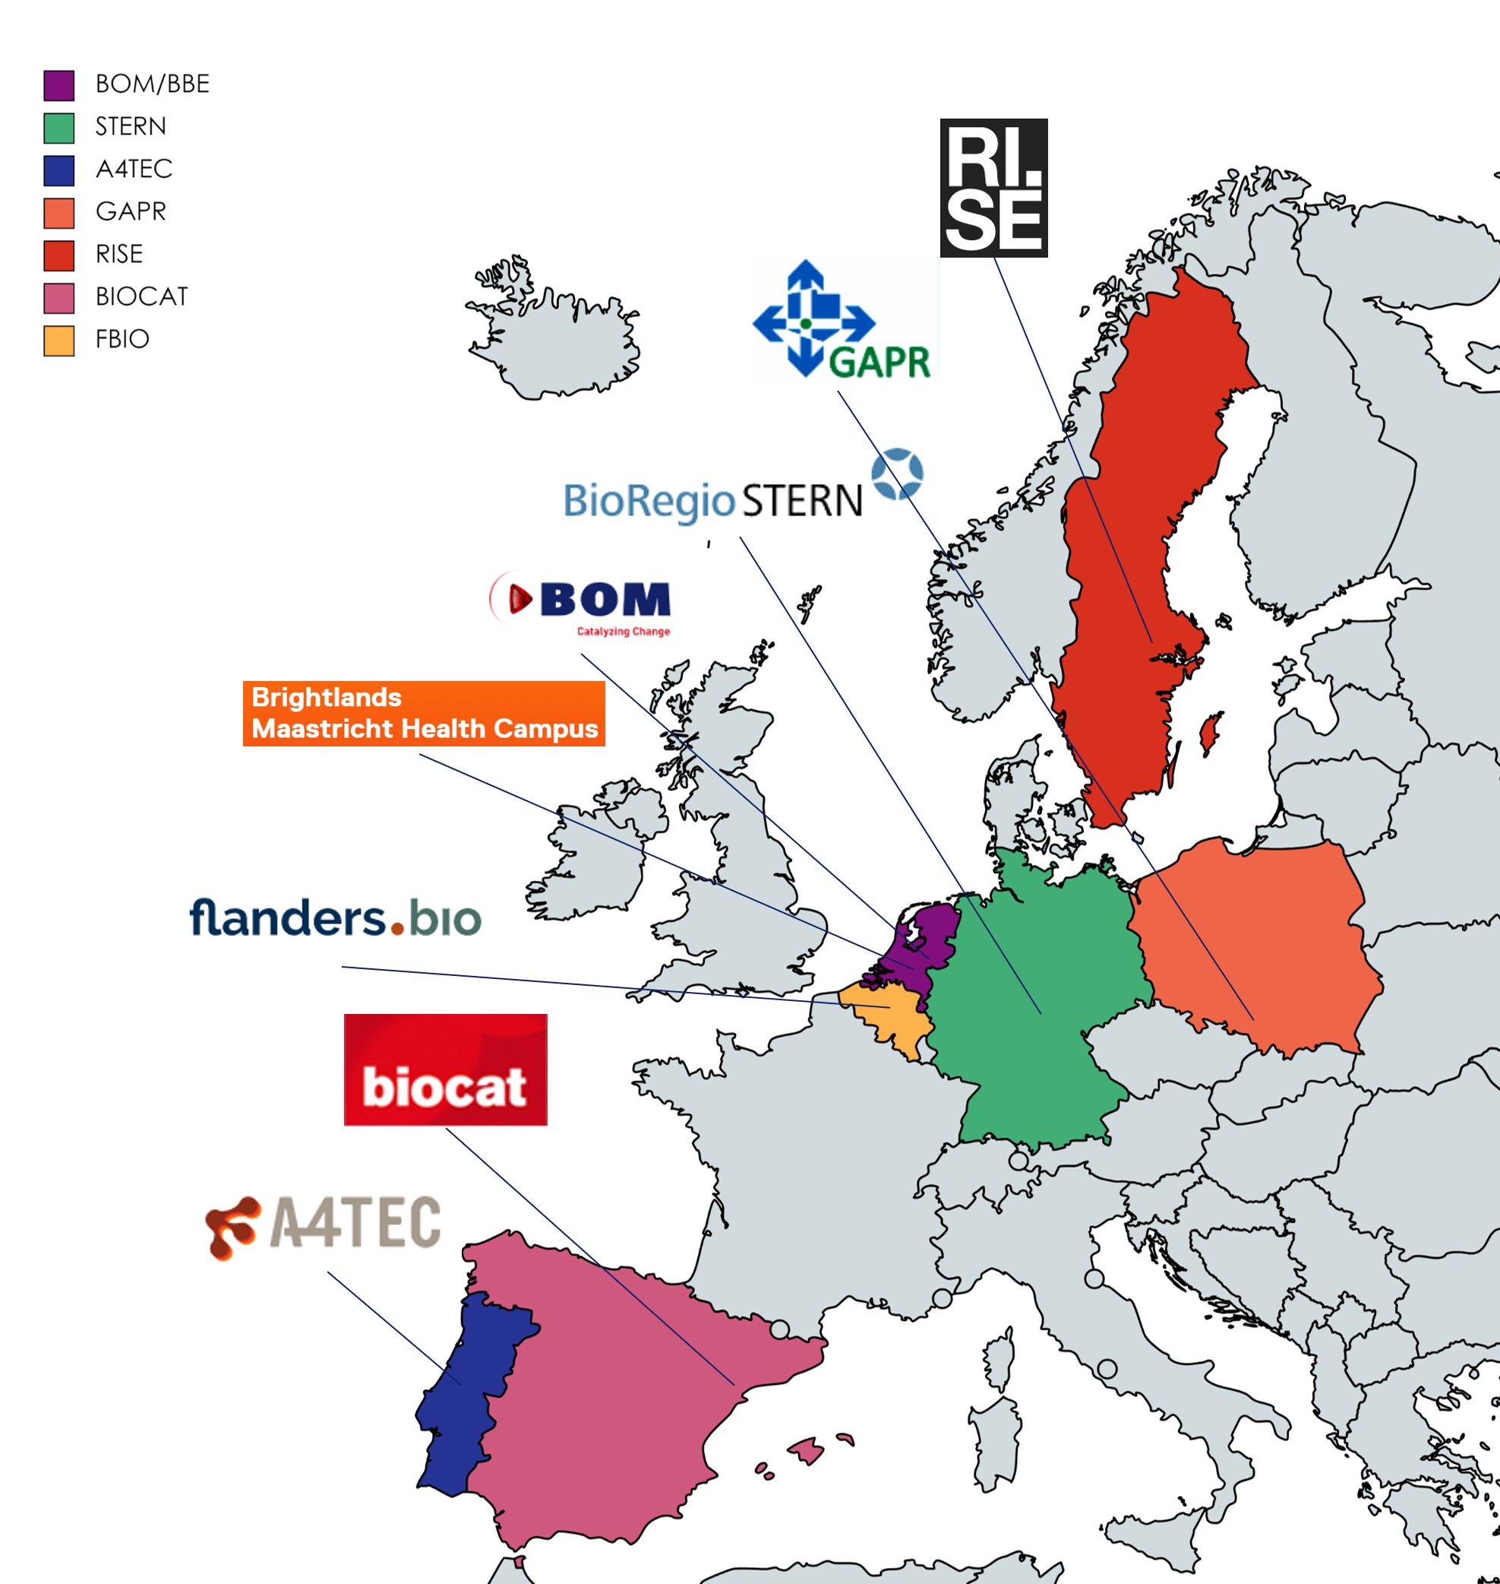
European Hub for Advanced therapies & Biomaterials (EHAB)
CHALLENGES
OPPORTUNITIES
Validation
Complex
Production
Financing
Public
acceptance
Legislation
Market access
Connected value chain
Innovative products
Shared expertise
New business models
Quicker market access
Increased acceptance
Faster market develop
ment
Cost reduction
Accelerate SMEs in AT&B*
The Project connects the AT&B innovation ecosystems to facilitate & accelerate the development of transformative health solutions
* AT&B: Advanced Therapies & Biomaterials

Slide 27




Concept
Involvement of the quadruple helix stakeholders represented and engaged by clusters associations
Recommendations for building a joint value chain pipeline for SMEs within the ATMP & Biomaterials sector
EHAB: strong involvement of regional/national/European authorities, NGOs on this topic, high level industry representatives, high level research representatives
Definition/establishment of a joint value chain pipeline for a European Hub for Advanced therapies and Biomaterials
National European innovation ecosystems
Innovation Leaders: BOM, FlandersBio, RISE, BRS
Strong innovators:
ReGEN, Medace
Moderate innovators:
A4tec, Biocat
Emerging innovators:
MedSilesia

Slide 28
Concluding remarks
Vanguard Initiative regions’ pilot activities leading by example in the post industrial transition

